Slide 1
Applications Of Micriobiome In Environment
Tran Thi My Qui

Slide 2
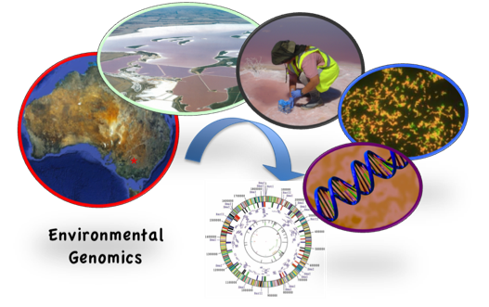
Environmental Metagenomics
a field of study that involves the genomic analysis of microbial communities directly sampled from natural environments (soil, water, air, or other habitats)
collective genomes of diverse microbial populations without the need for cultivation

Slide 3
Importance in understanding microbial diversity
1. Uncovering hidden diversity
2. Functional potential analysis: metabolic pathways, antibiotic production, and other functions that contribute to ecosystem processes
3. Biogeochemical cycling: nutrient cycling, carbon fixation and decomposition
4. Ecosystem resilience and adaptation
how microbial communities adapt to environmental changes and disturbances
predicting ecosystem resilience and understanding the impacts of human activities on microbial ecosystems

Slide 4
Significance of Environmental Metagenomics
Impact on environmental conservation
biodiversity assessment
indicator species and environmental health
monitoring microbial responses to climate change
bioremediation strategies: identifying microbial species with the potential to degrade pollutants => cleanup
Applications in agriculture and soil health
soil microbiome characterization
plant-microbe interactions
biofertilizer and microbial inoculants
disease suppression

Slide 5
Significance of Environmental Metagenomics
Insights into Human Health and Disease
Microbiome-health connections
Antibiotic discovery and monitoring antimicrobial resistance (AMR)
Microbial ecology: homes and hospital
Disease surveillance and outbreak prediction

Slide 6
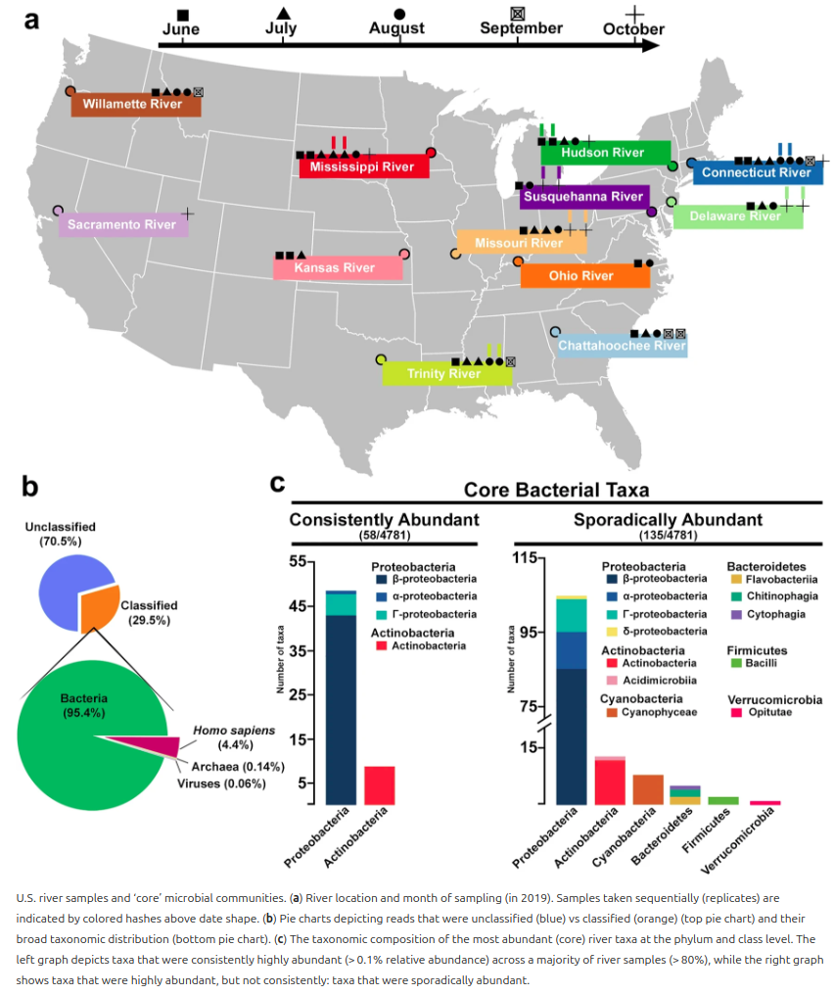
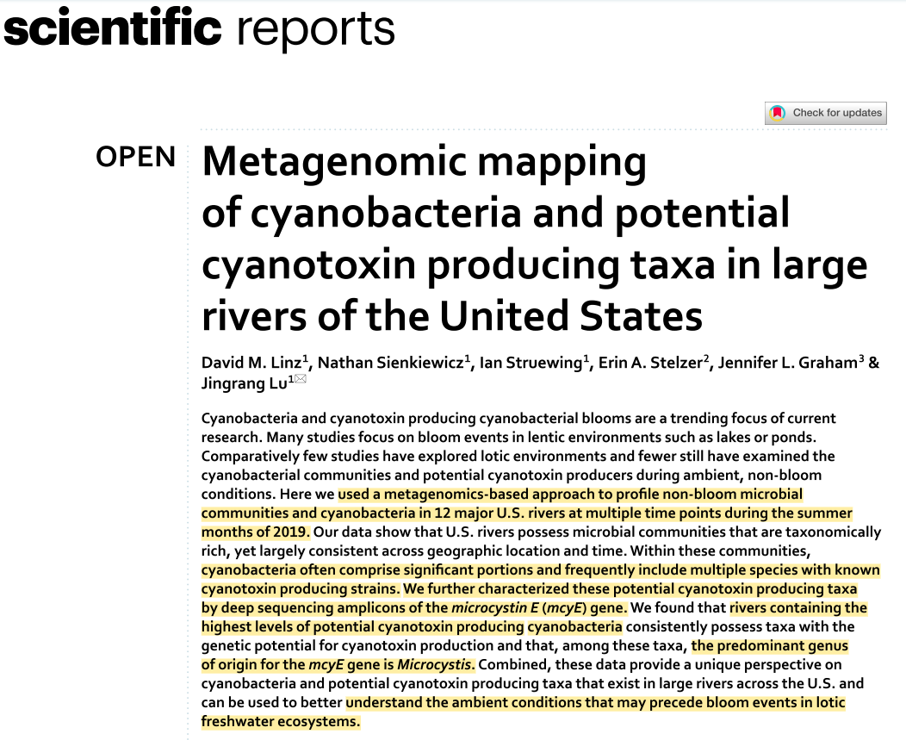
https://doi.org/10.1038/s41598-023-29037-6

Slide 7
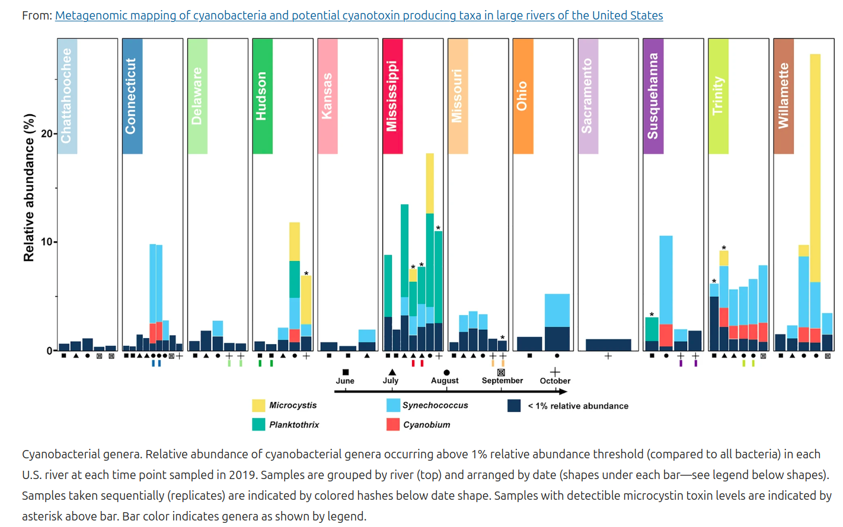
https://doi.org/10.1038/s41598-023-29037-6

Slide 8
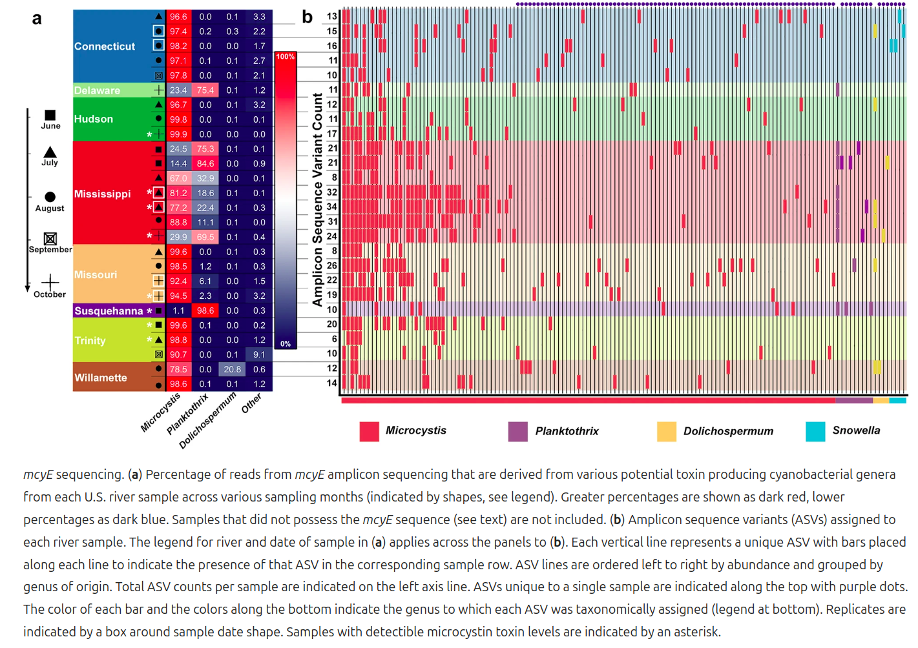
https://doi.org/10.1038/s41598-023-29037-6

Slide 9
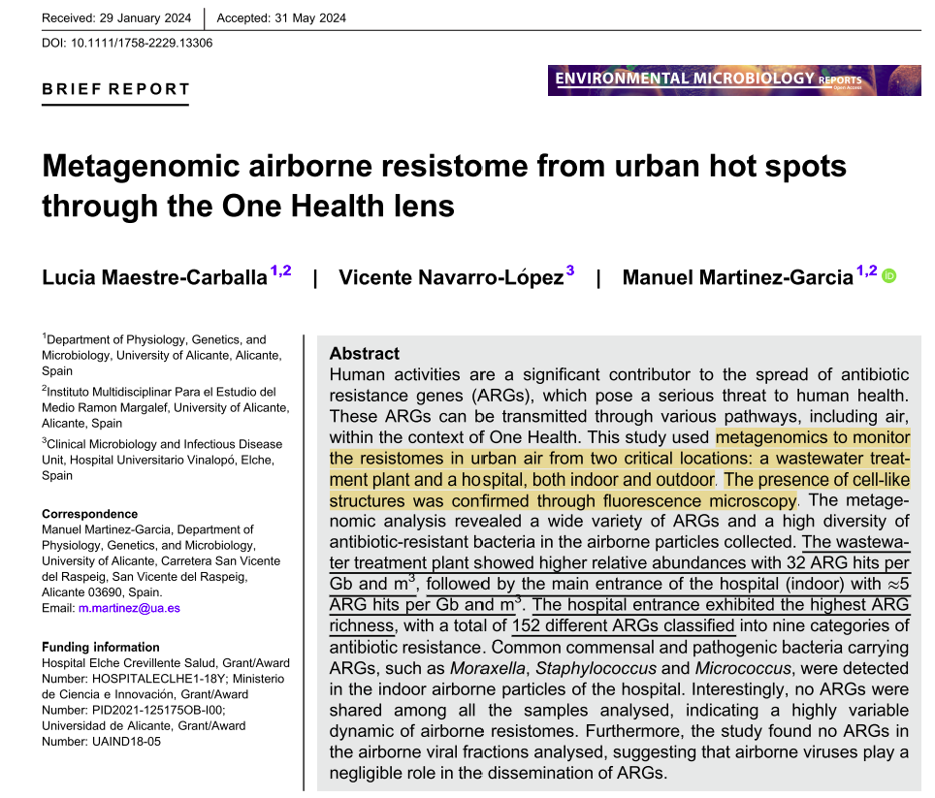
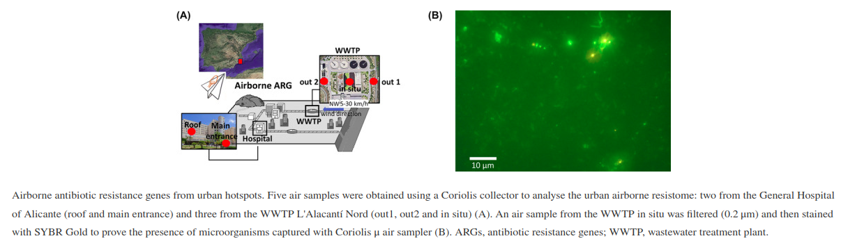
https://doi.org/10.1111/1758-2229.13306

Slide 10
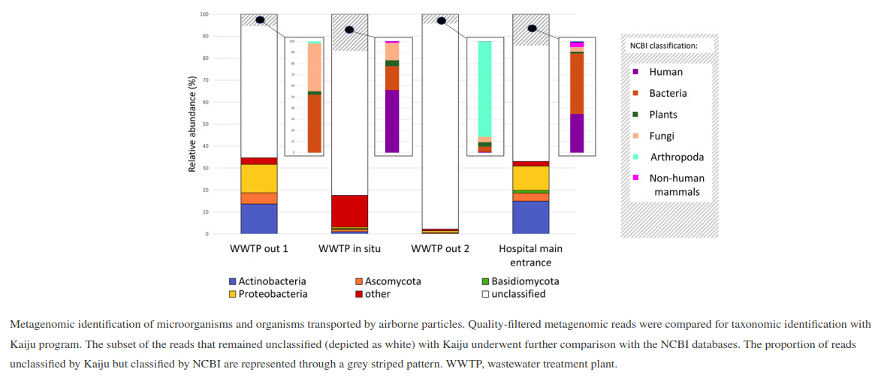
https://doi.org/10.1111/1758-2229.13306

Slide 11
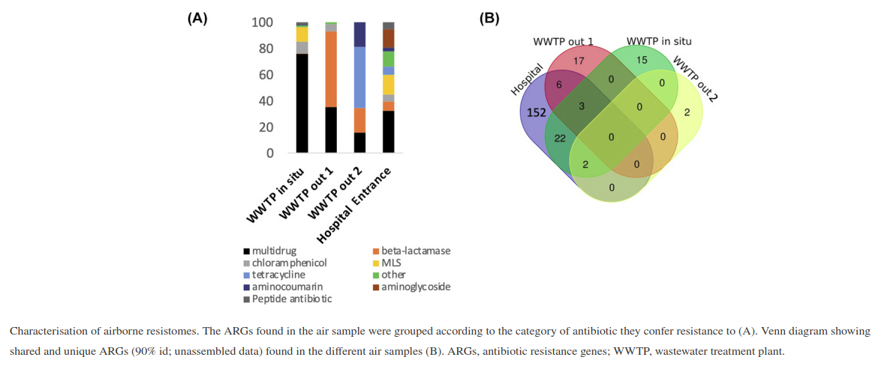
https://doi.org/10.1111/1758-2229.13306

Slide 12
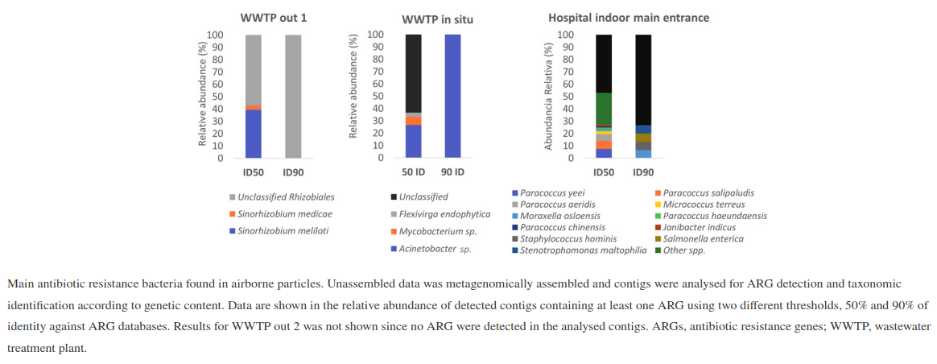
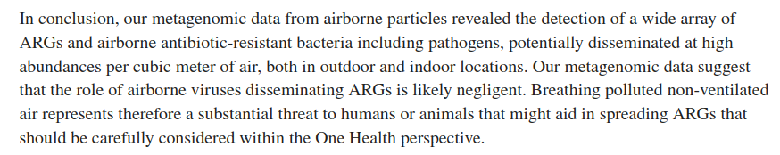
https://doi.org/10.1111/1758-2229.13306

Slide 13
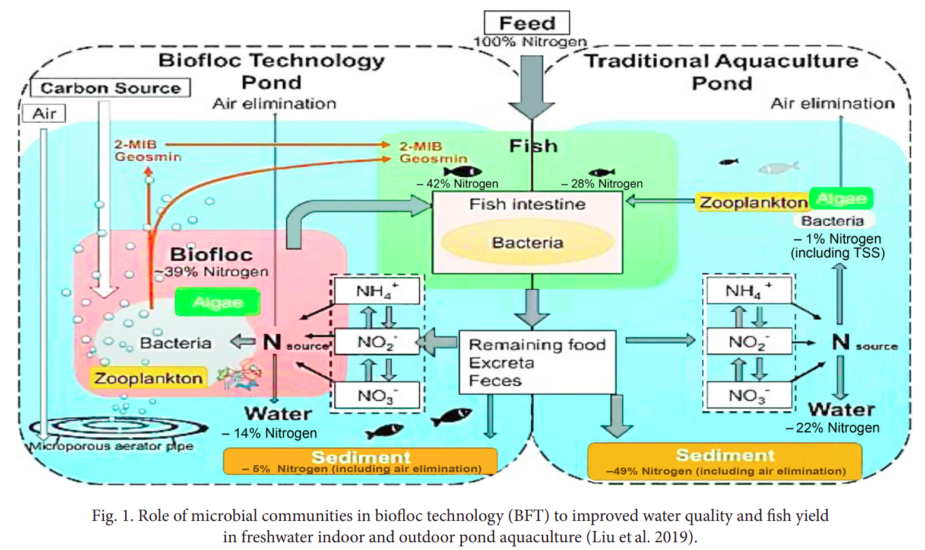
Application of microbiome in aquaculture
Biofloc Technology

Slide 14
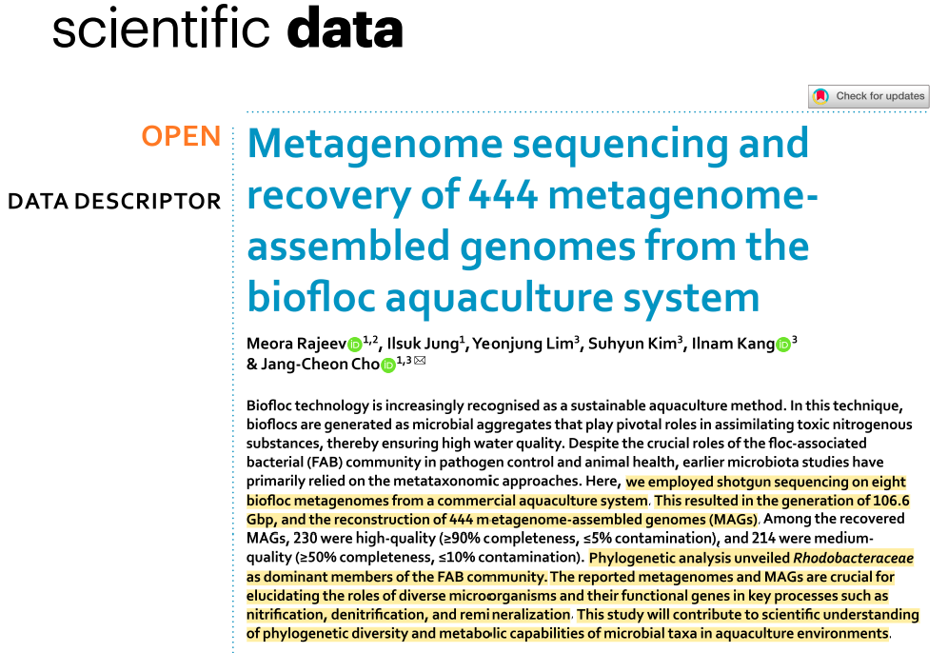
Application of microbiome in aquaculture

Slide 15
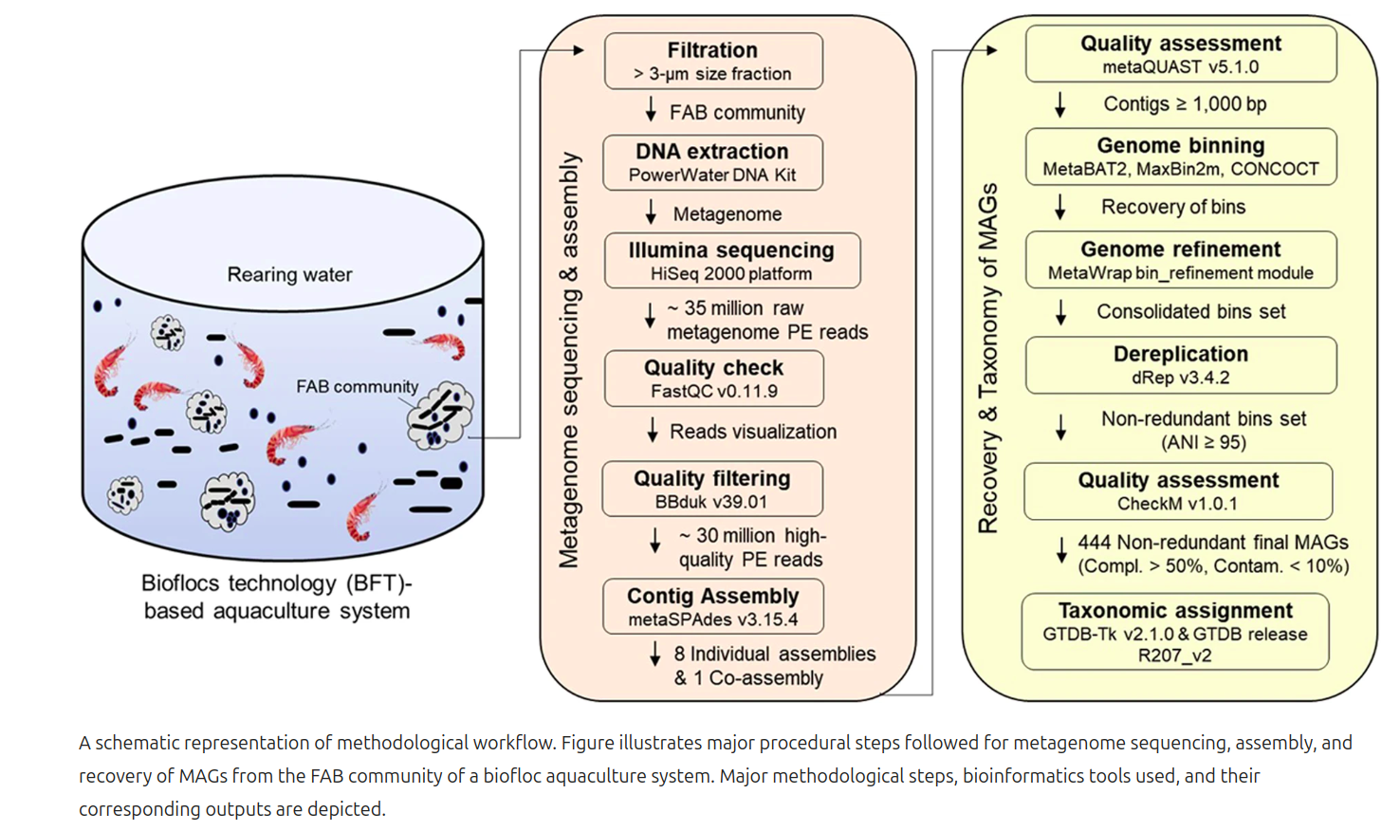
FAB: floc-associated bacterial
https://doi.org/10.1038/s41597-023-02622-0

Slide 16
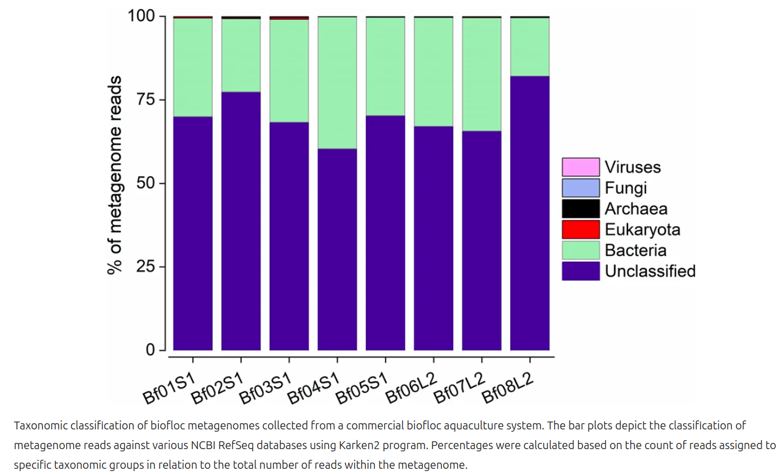
https://doi.org/10.1038/s41597-023-02622-0

Slide 17
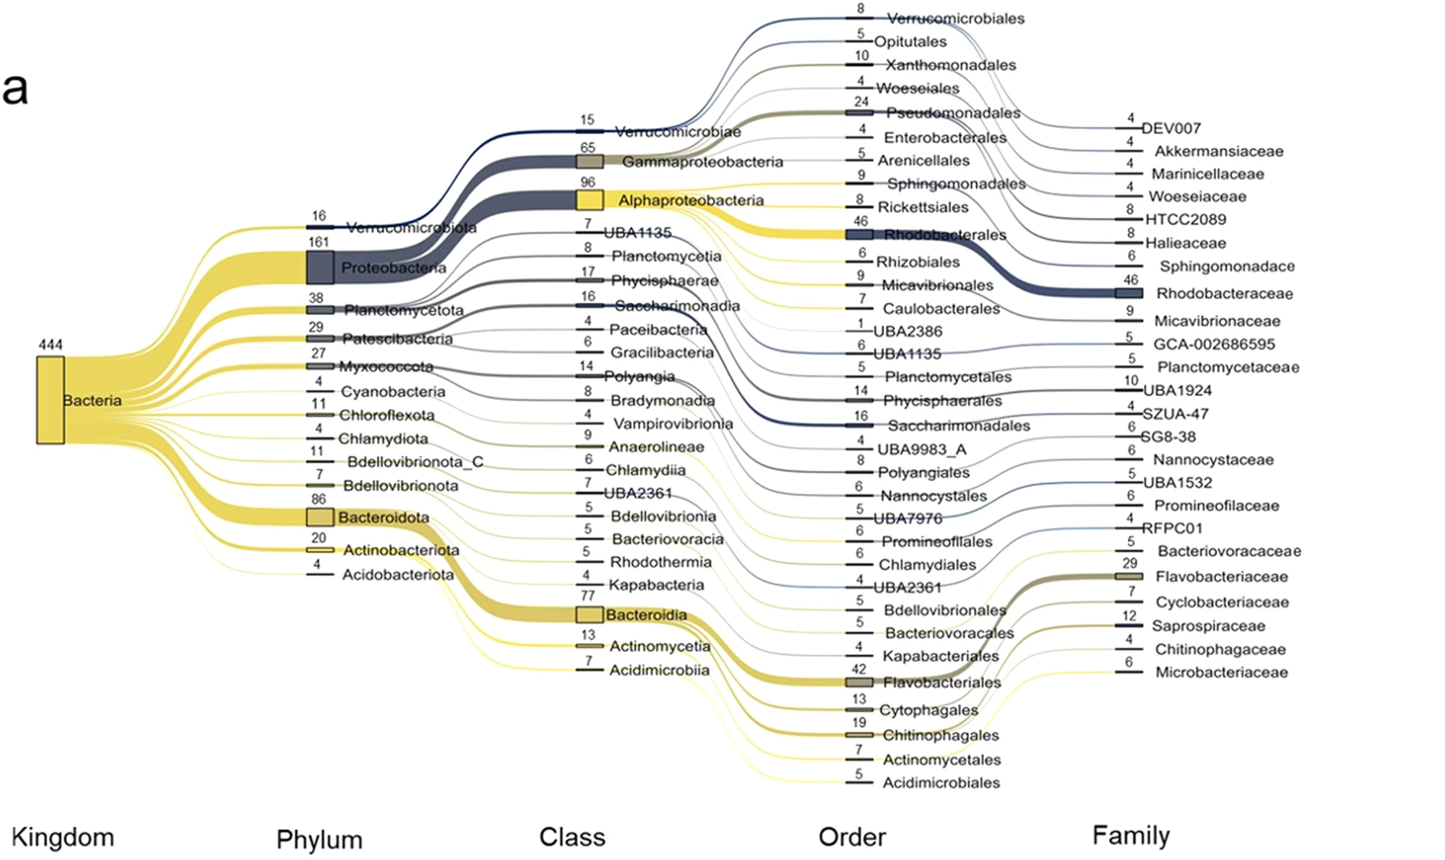
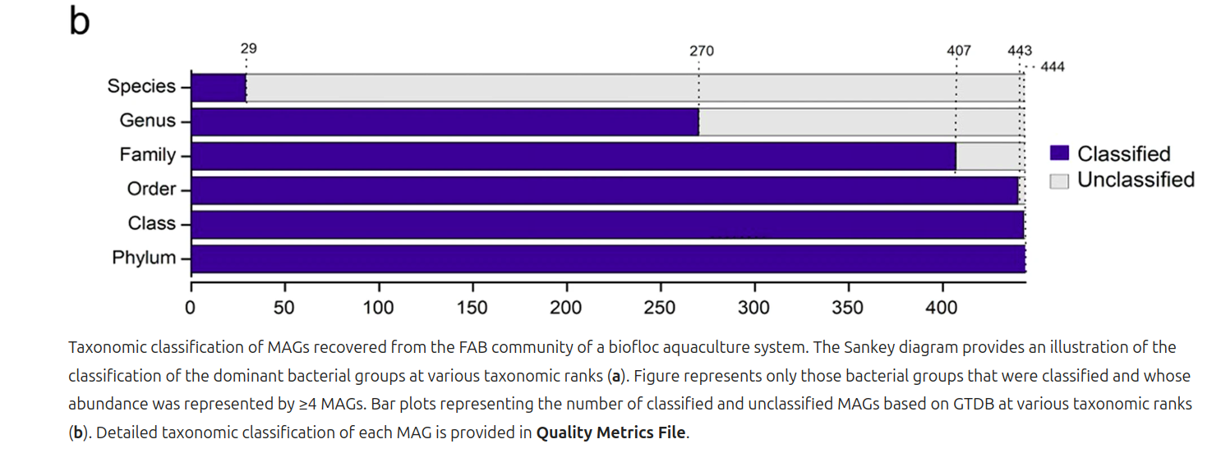
https://doi.org/10.1038/s41597-023-02622-0

Slide 18
Thank you for your listening!

